Slide 1
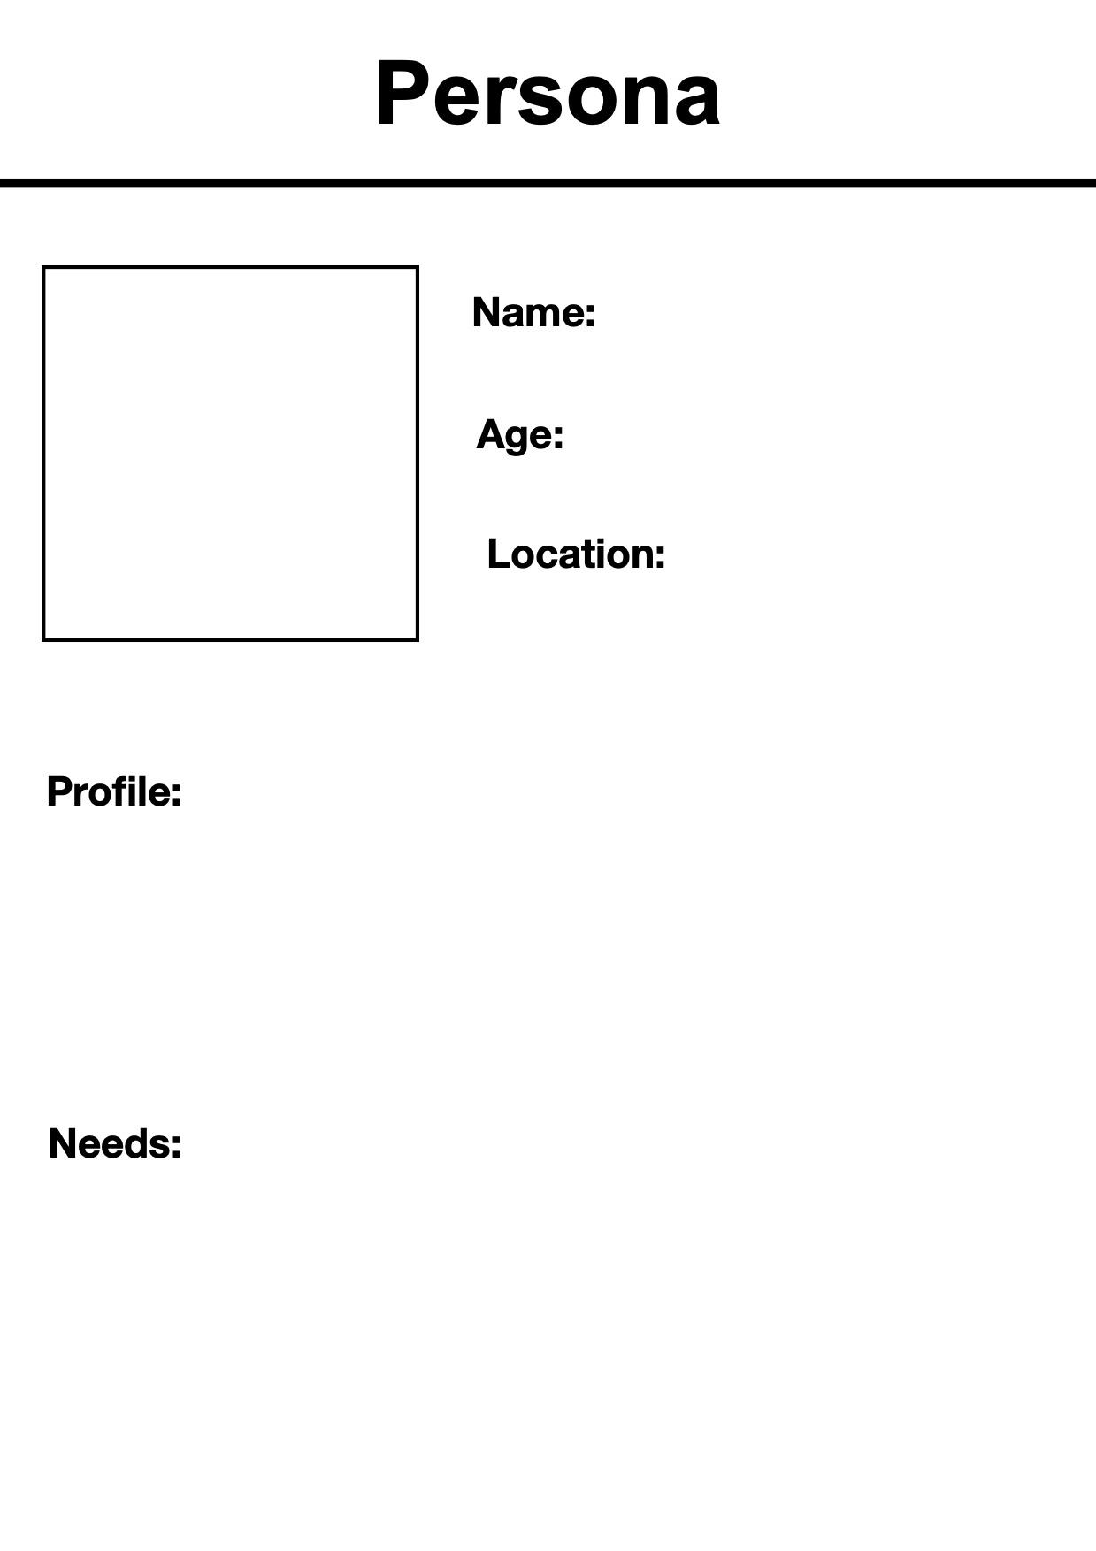

Liam Parker
26
Apartment studio in North York/Simcoe
Liam, a young professional who was working in Loblaws as an analyst, lost his job. So he is currently looking to upskill himself in AI.
Liam is searching for affordable upskilling options in AI, either by doing a Master’s or any professional certifications in the GTA/ Durham region.

